Slide 1

Towards generative models of rich metaphoric gesturing
University of Glasgow
Master’s Thesis Presentation Department of Neuroscience and Psychology 12 August 2019
Carolyn Saund

Slide 2
Metaphoric Gestures

Slide 3
What Are They?
Metaphoric Gestures
Gestures which “present an image of an abstract concept.” (McNeill 1992)
Evocative of a semantic idea
“abstract idea is concrete object” (Grady 1997)
Scene or Semantic-Based (Lhommet & Marsella 2013)
We use more than one at a time (Saund et al. 2019 to appear)

Slide 4
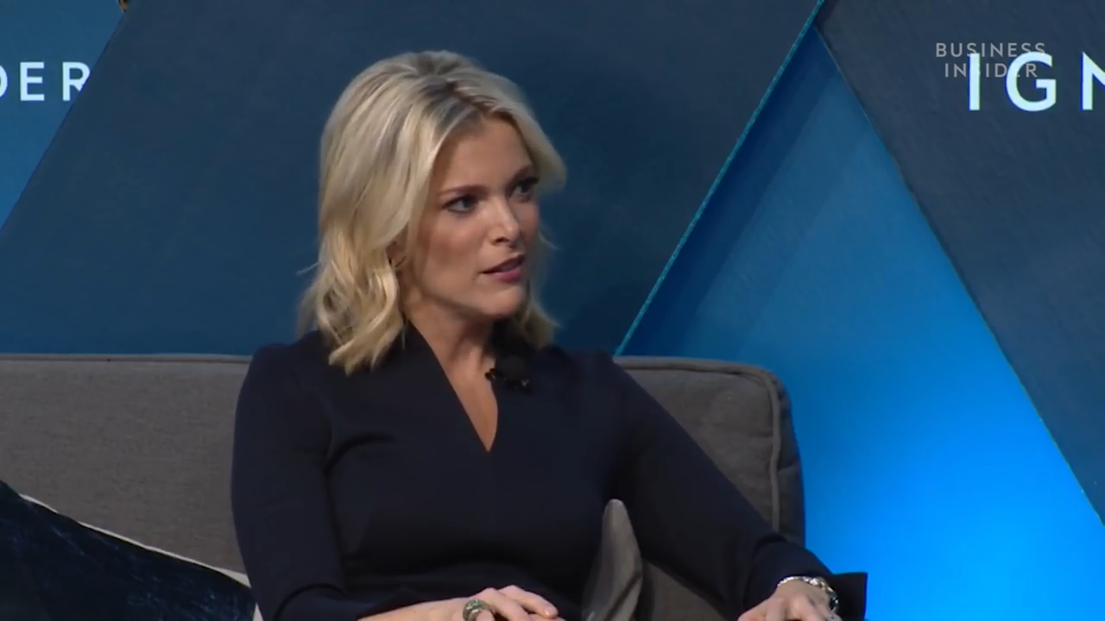
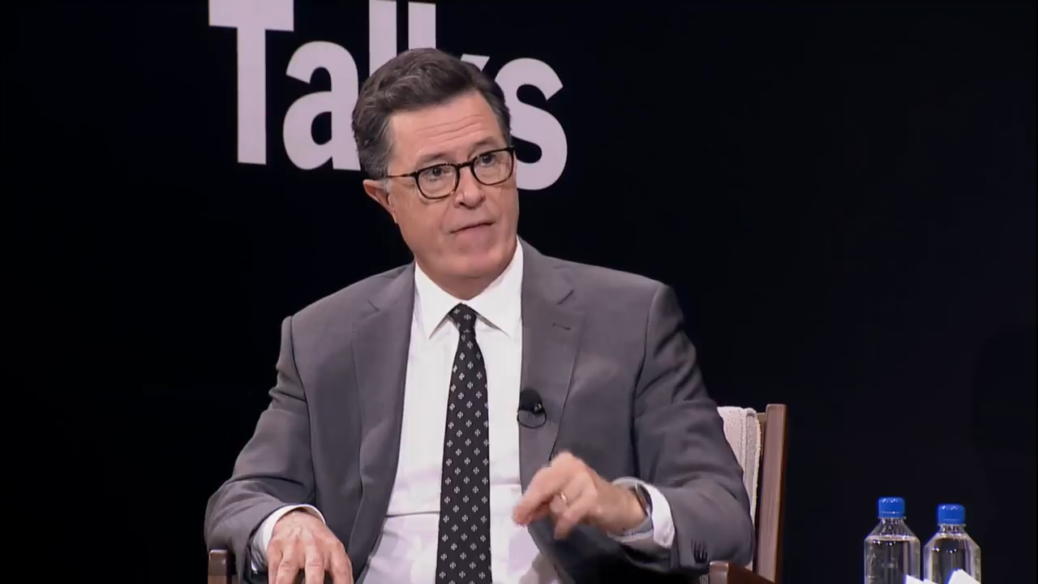
Examples
Metaphoric Gestures
Examples

Slide 5
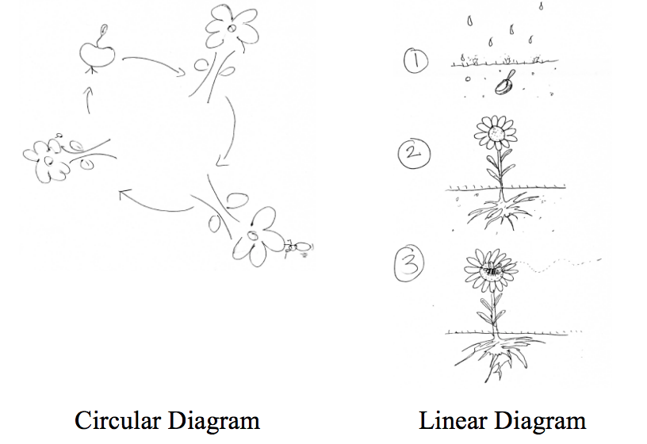
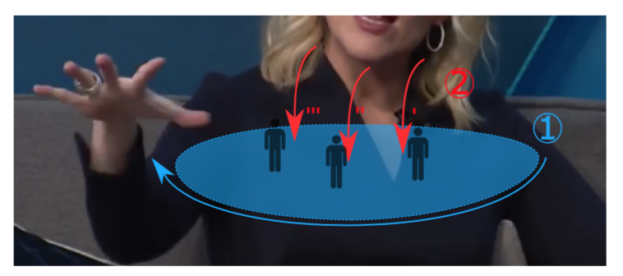
Their Functions
Metaphoric Gestures
Modeling For Use In Virtual Agents and Robots because metaphoric gesture:
Affects thought in viewer (Jamalian & Tversky 2012)
Influences perceptions about the speaker (Goldin-Meadow & Alibali 2006)
Is a window into cognition (Cienki & Koenig 1998)
Jamalian & Tversky 2012
Saund et al. 2019 to appear

Slide 6
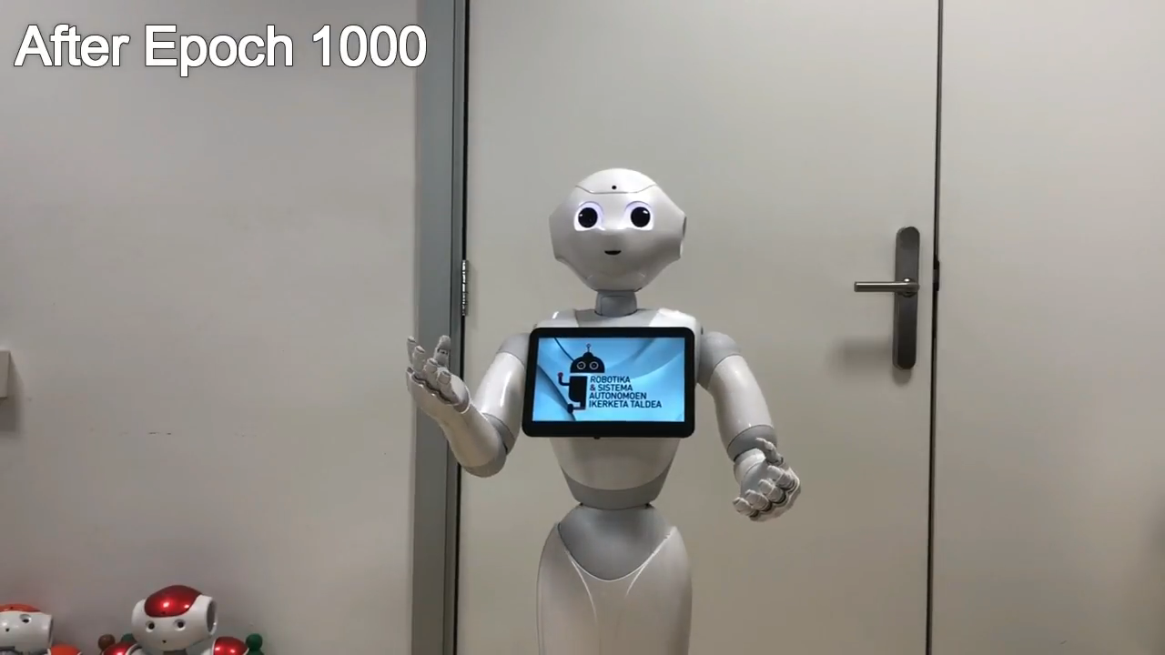
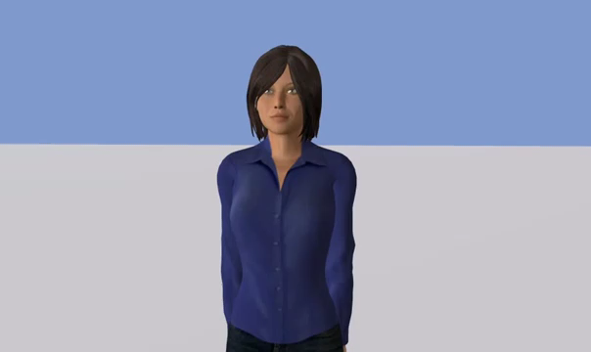
Modeling Examples
Metaphoric Gestures
Camacho Piris 2017
Deep learning is somewhat effective… but doesn’t tell us much about cognition
Largely built from surface text… but sometimes the text is irrelevant
Ravanet et al. 2018

Slide 7
Experiment:
Interpretation of Simultaneous Gestural Metaphors

Slide 8
Goals
Experiment
Interpretations of multi- and single-metaphoric gestures
What is interpretable from multiple metaphors?
How do physical semantic metaphors combine to influence interpretation?
How consistent are these interpretations?

Slide 9
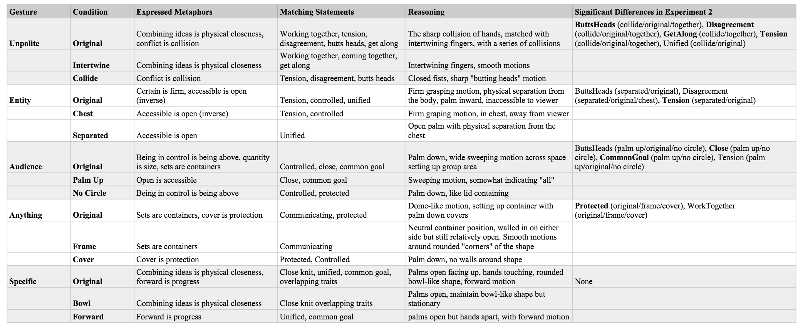
Hypotheses
Experiment
More metaphors in play means a less clear message
But the message is still there!
We can raise and lower rankings/scores on specific metaphors with specific alterations

Slide 10
Experimental Design
Experiment
Measure participant interpretation using…
Free Response: “She is talking about a group of people, what do you think she is saying?”
Rankings and ratings of fixed statements (i.e. “This group of people is working together to solve a problem.”)
Online Data Collection
Amazon Mechanical Turk (n=646)

Slide 11

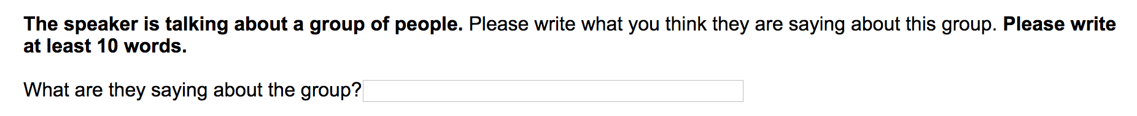
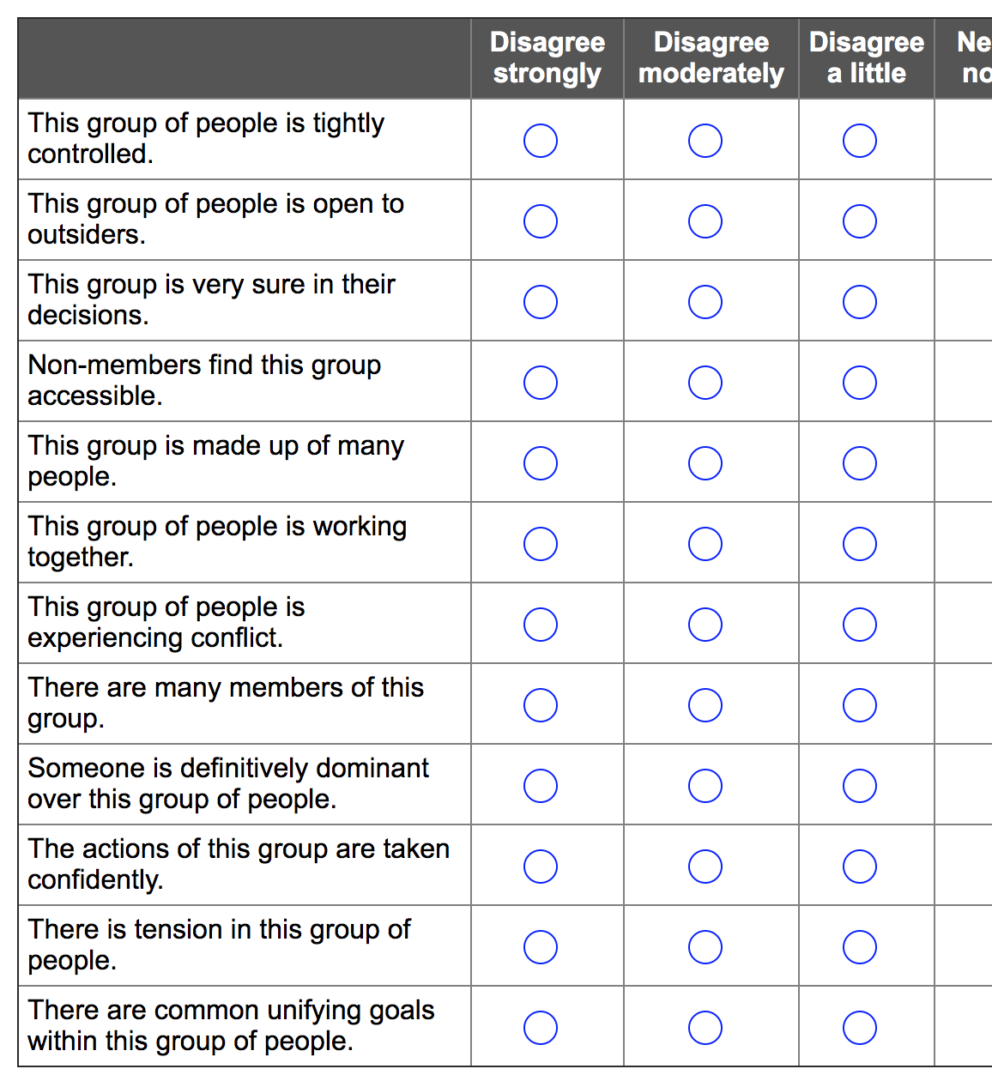
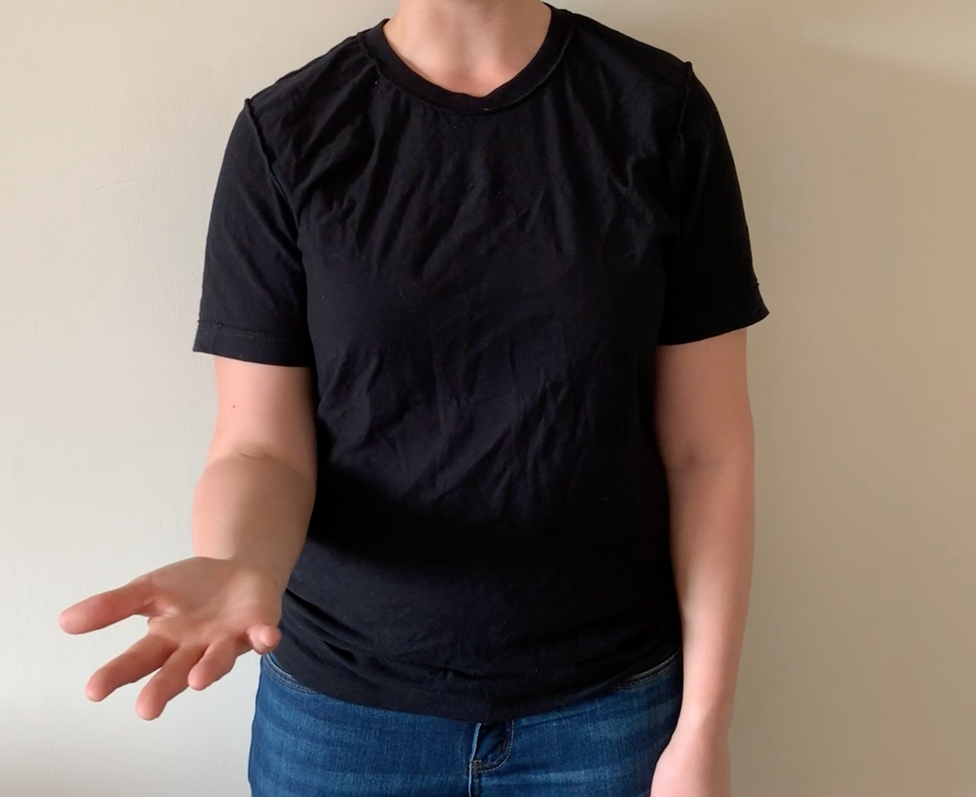


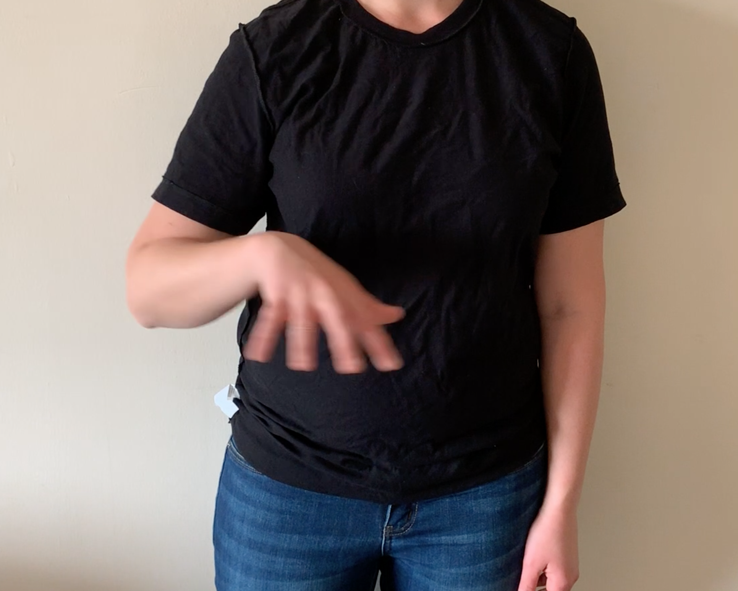
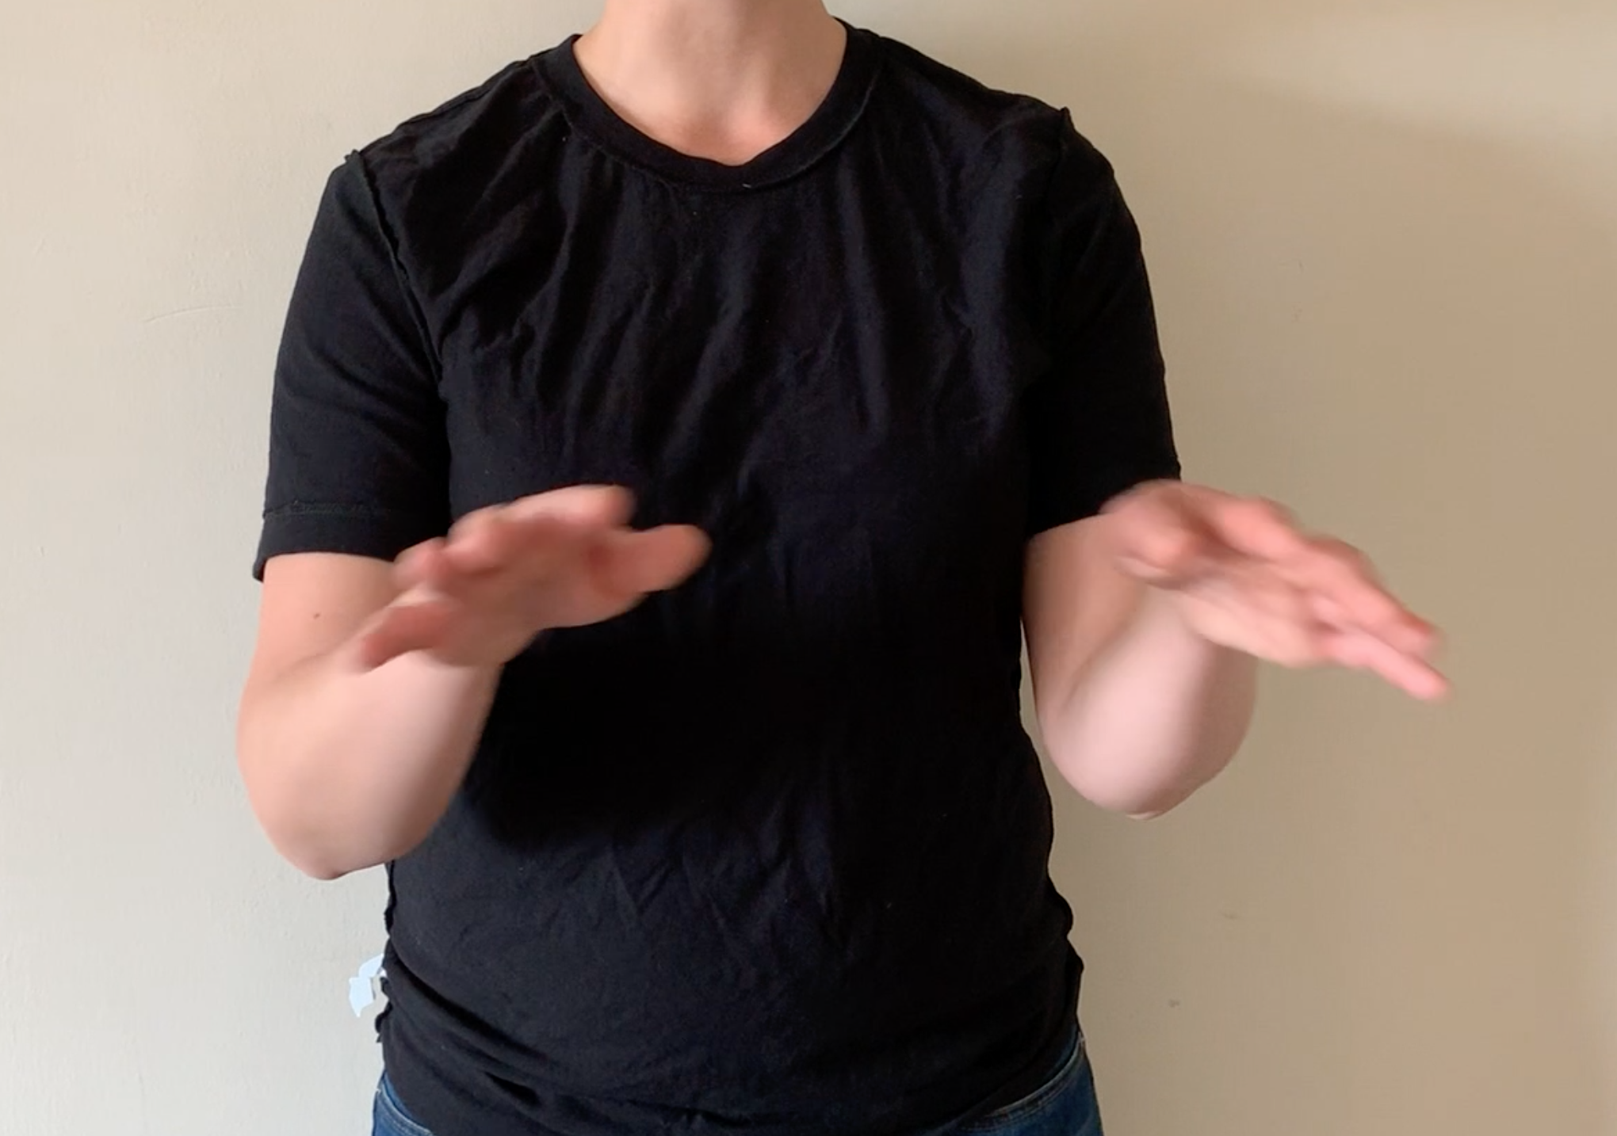
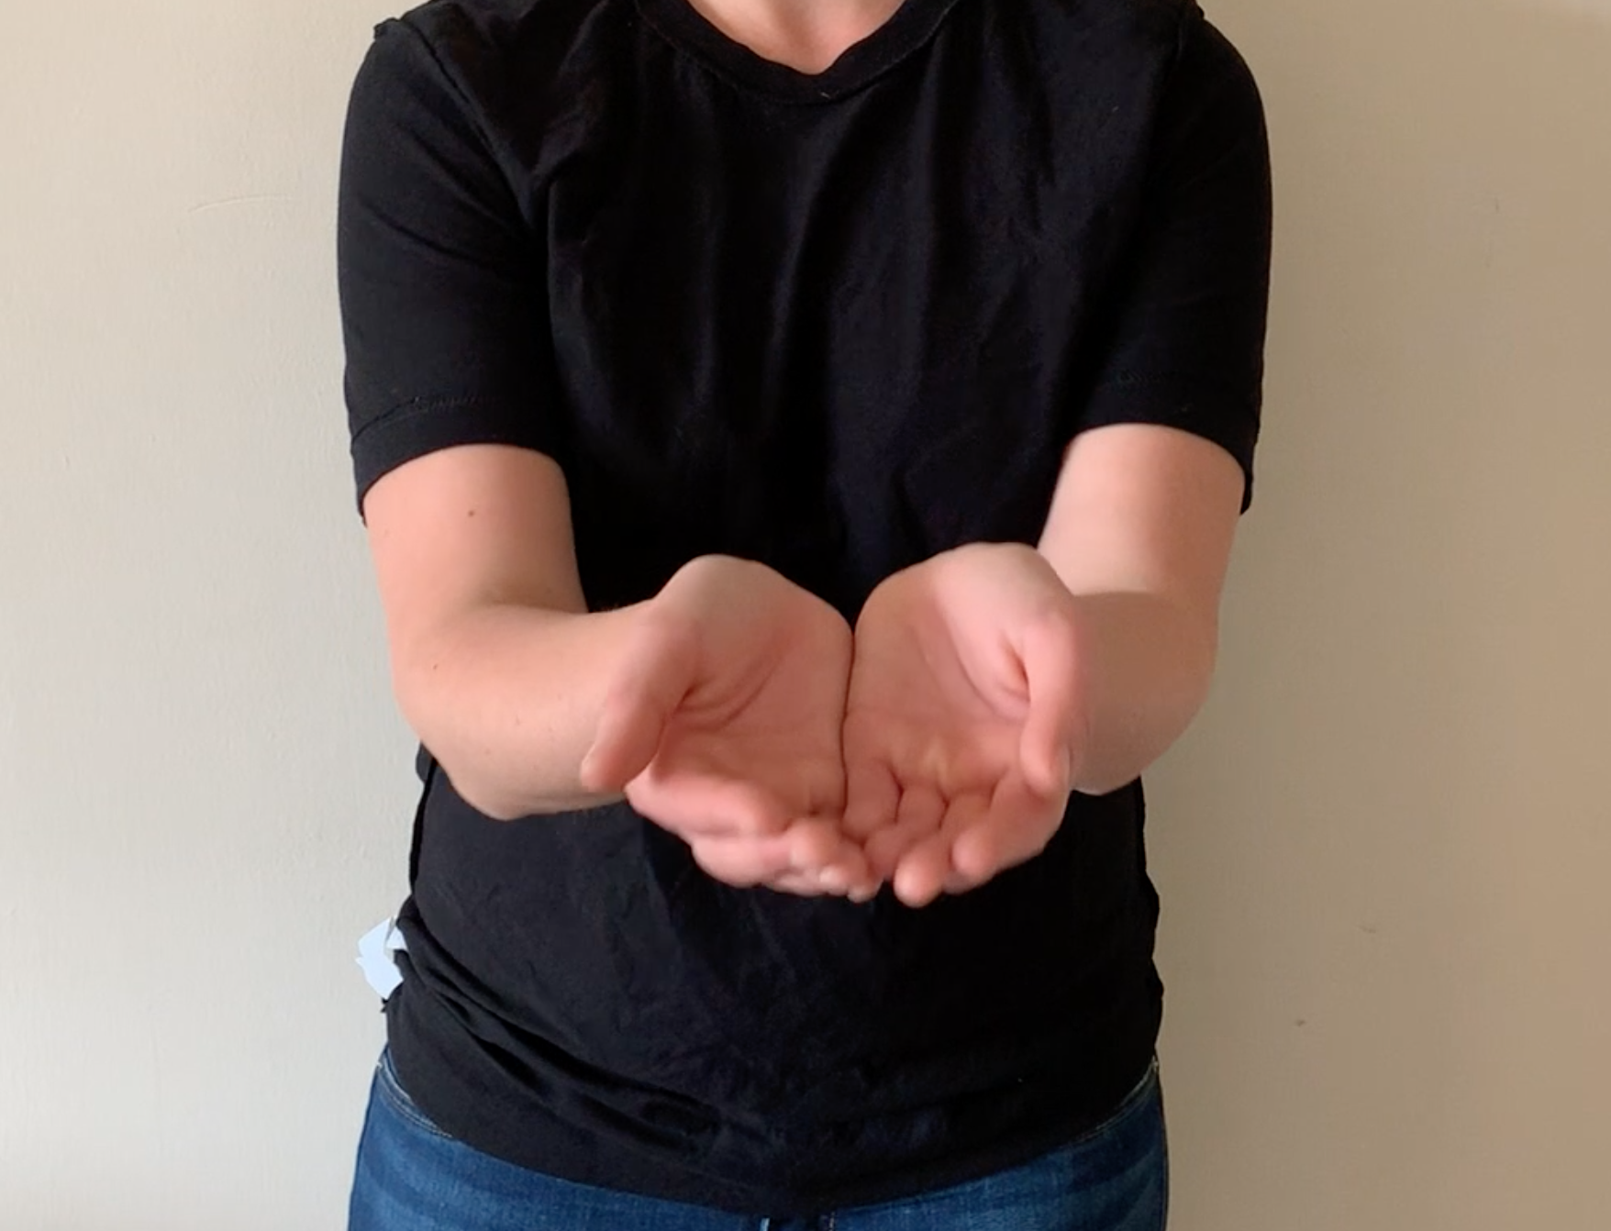

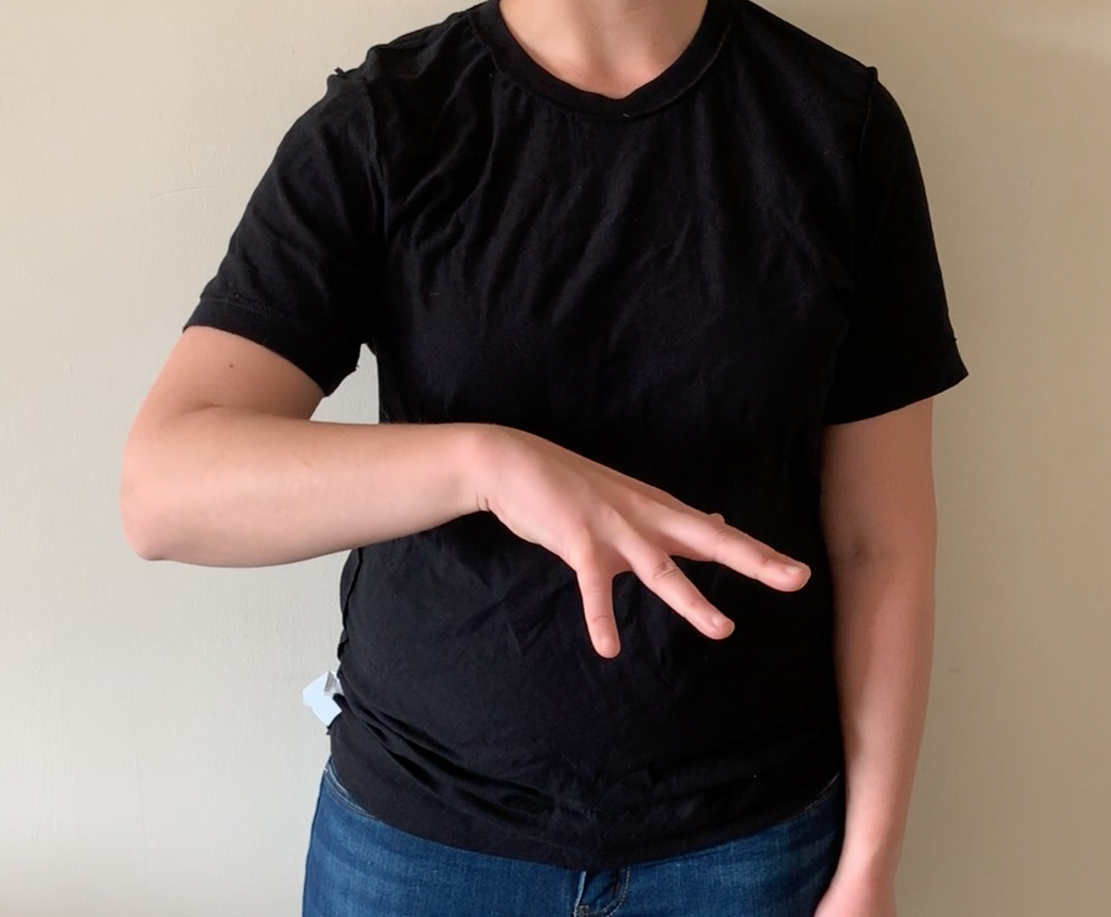
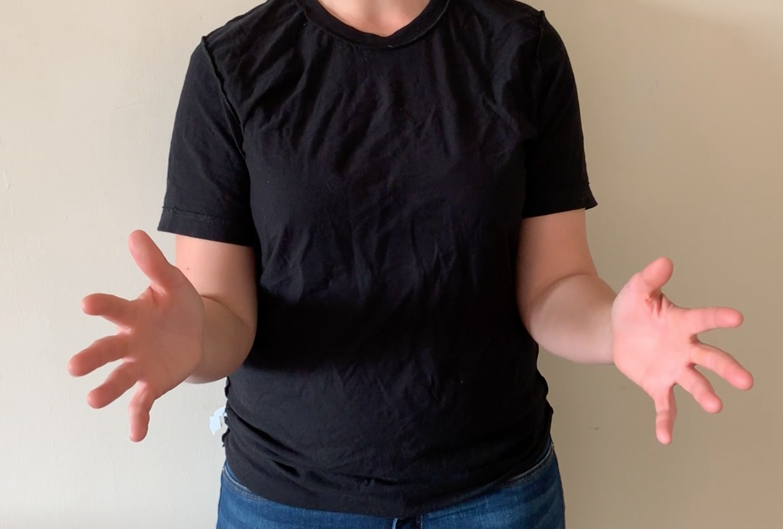
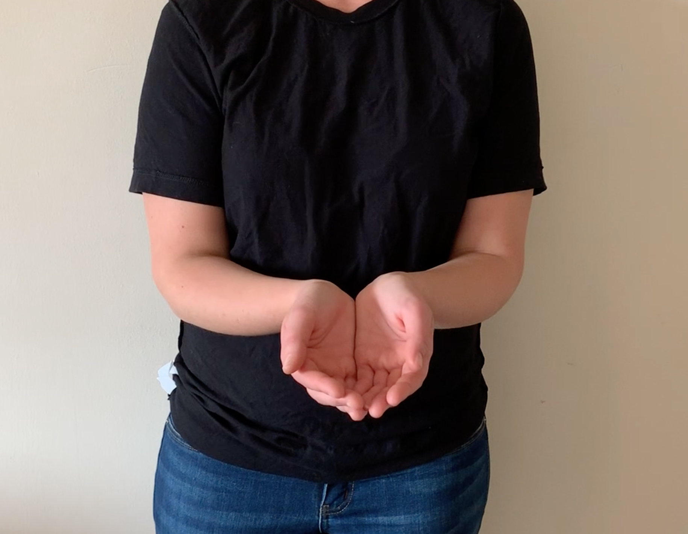

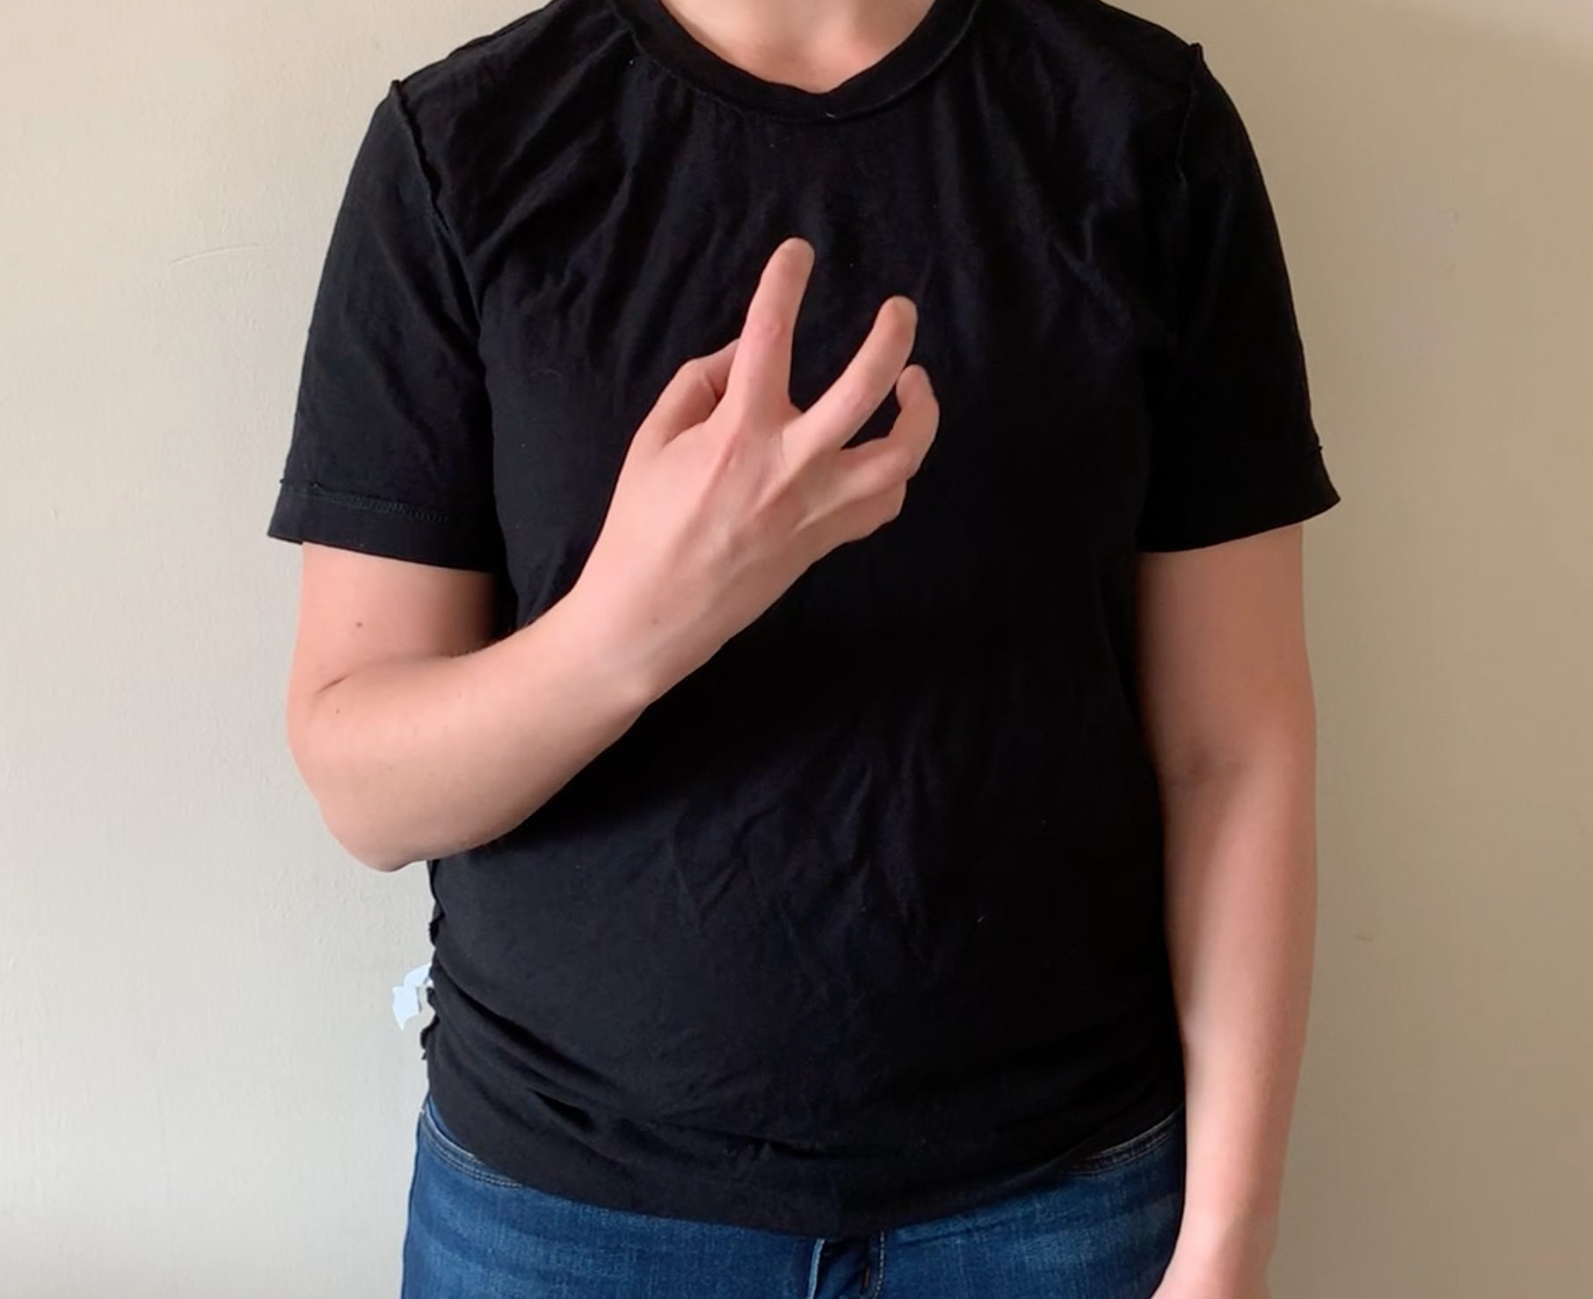
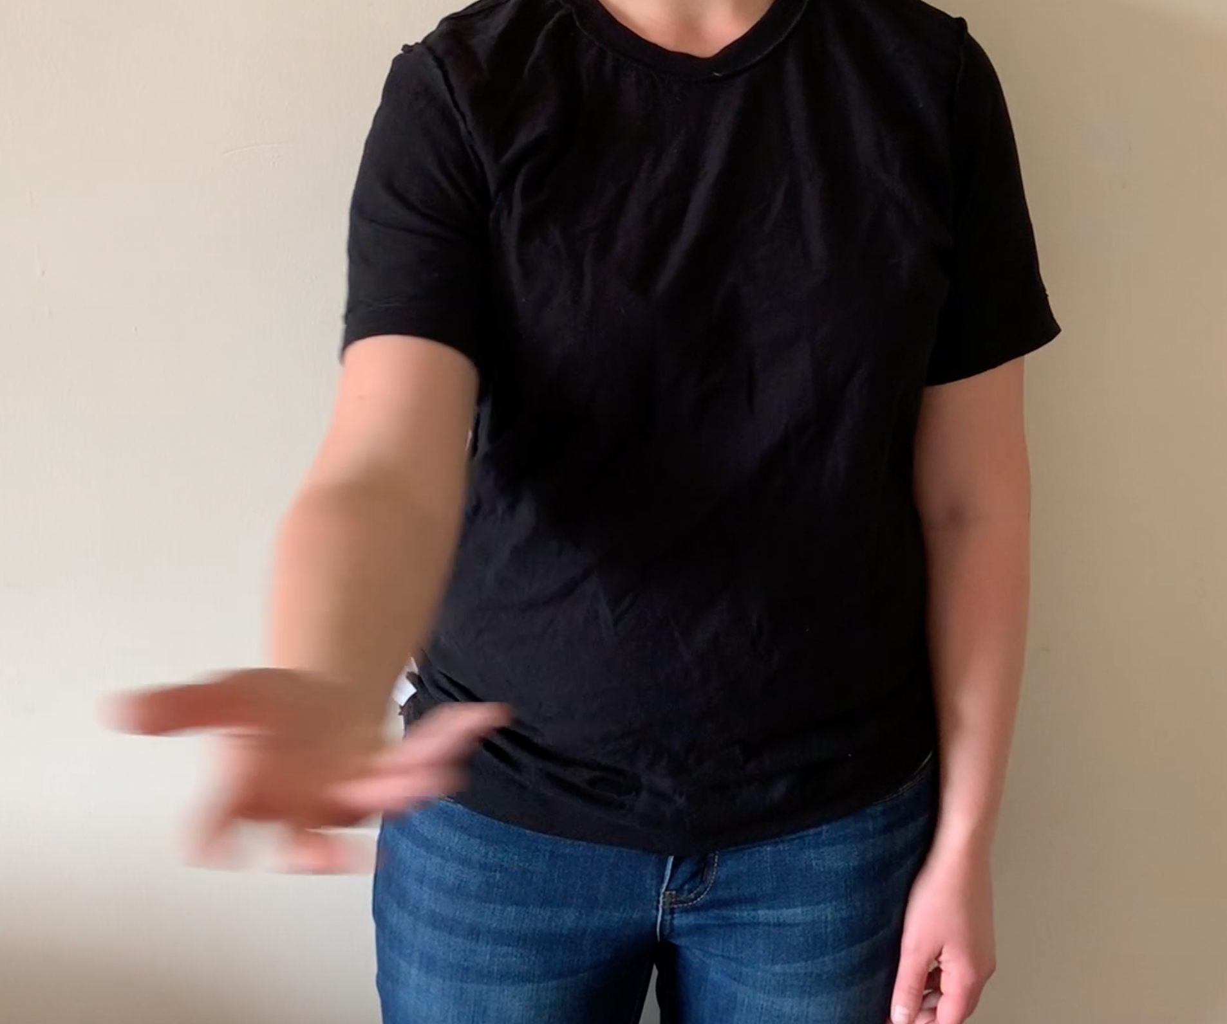
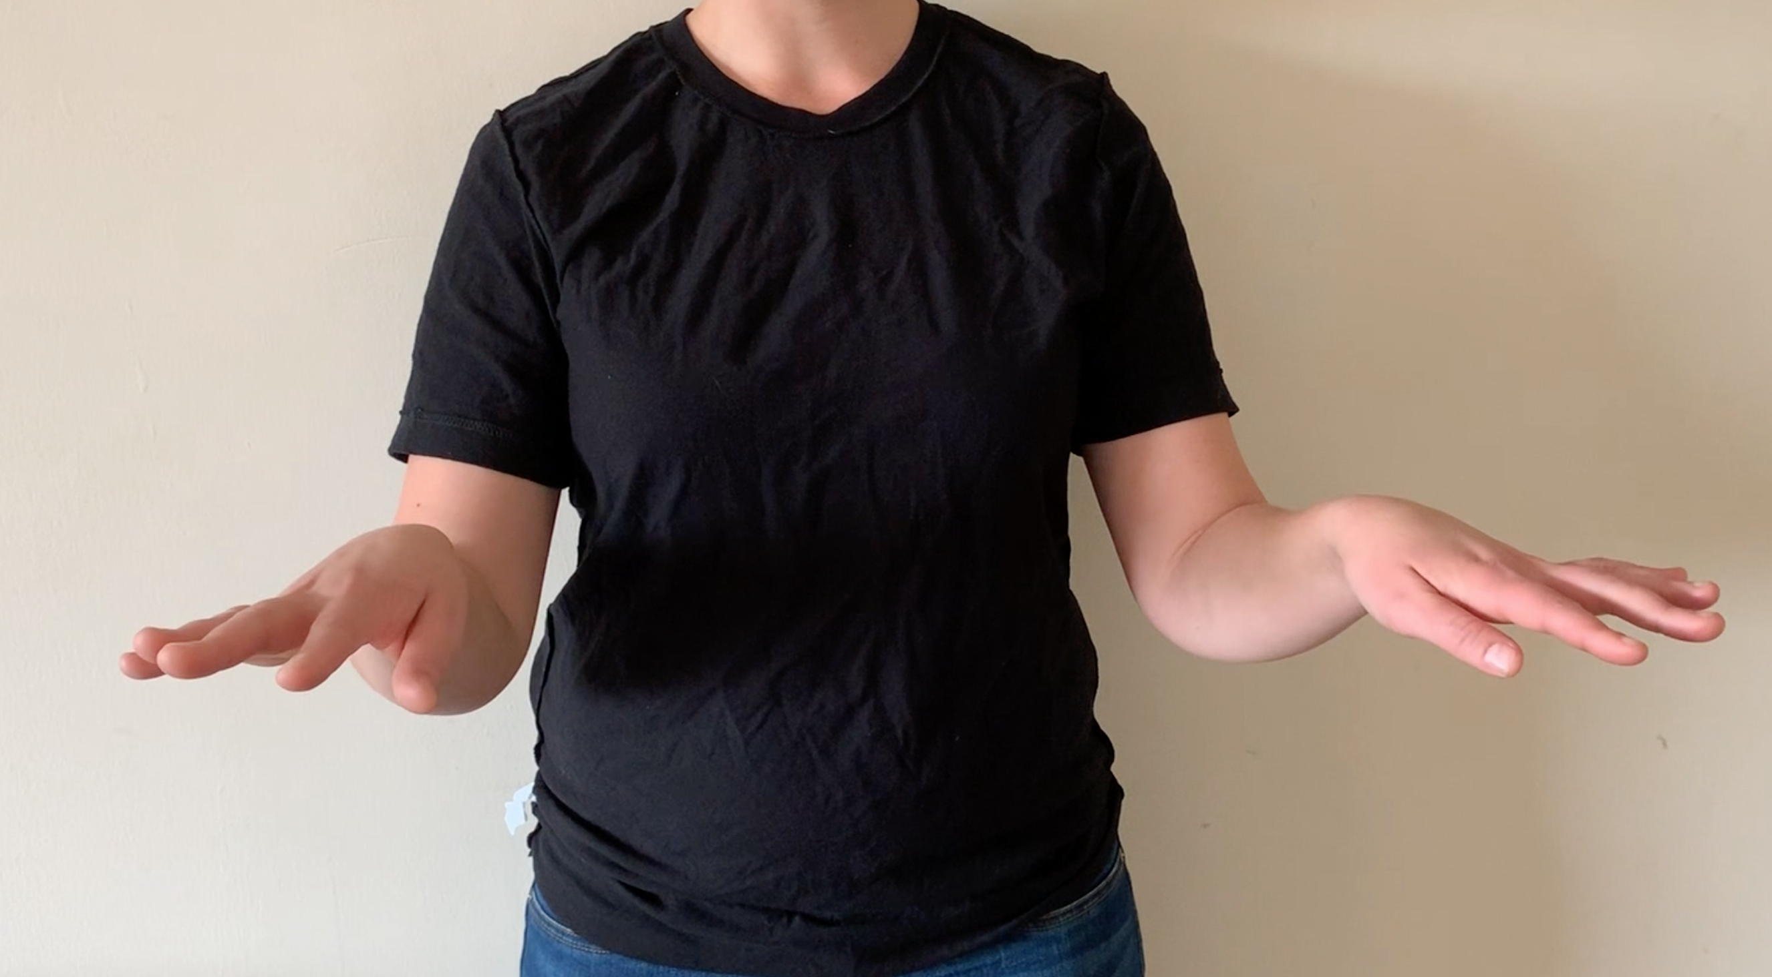
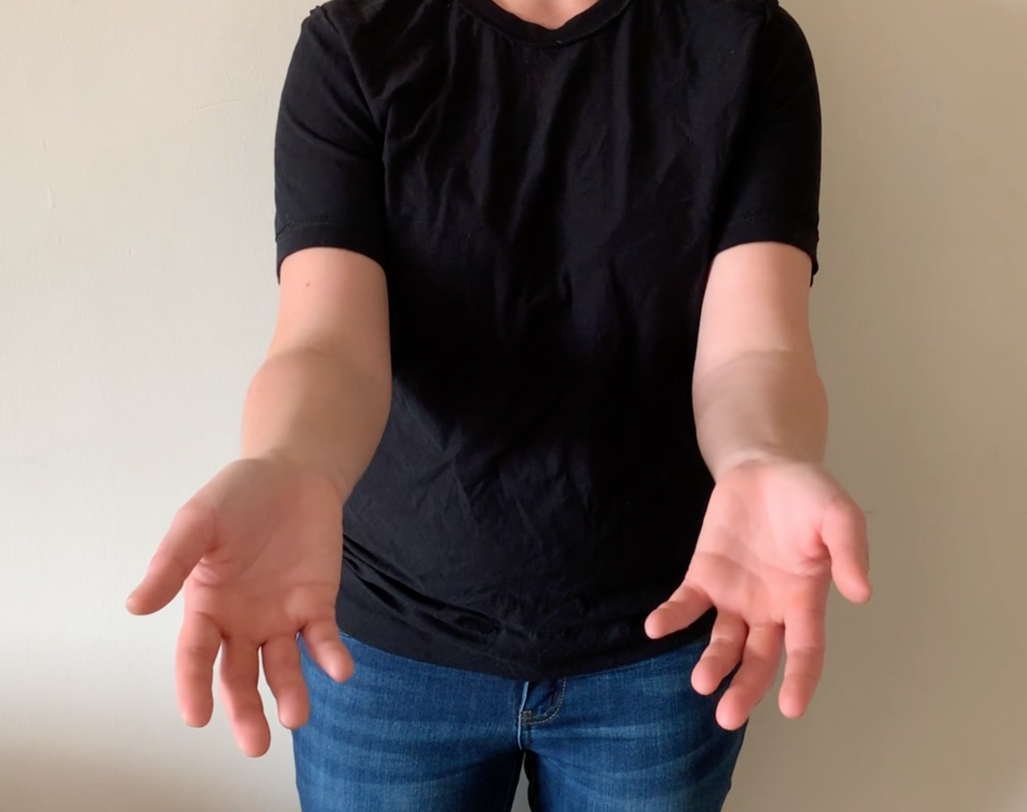
Setup
Experiment
Gesture 5
Gesture 1 | Gesture 2 | Gesture 3 | Gesture 4
 | 1

Slide 12
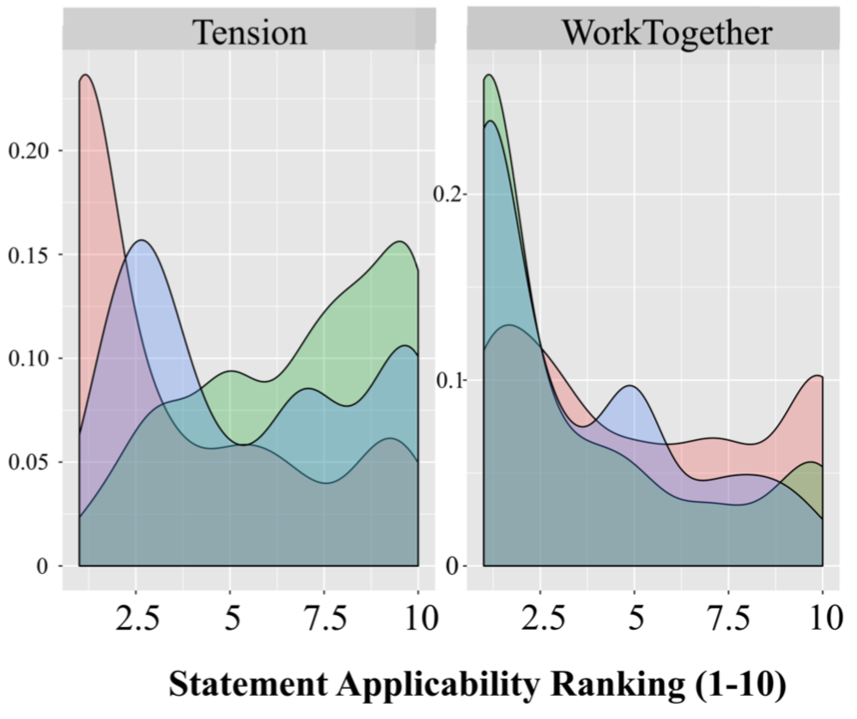
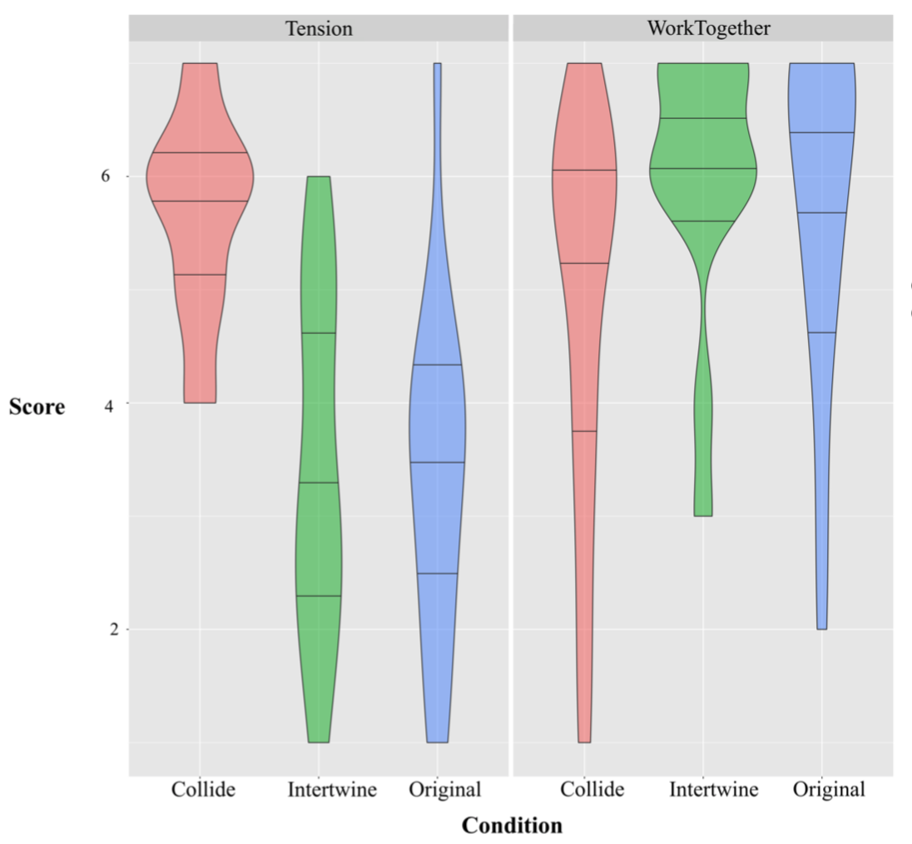
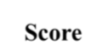
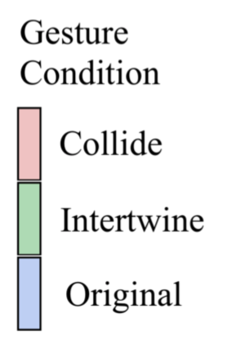
Results
Experiment
t-test to determine significance in trends

Slide 13
Findings
Experiment
Interpretations do differ… to some extent
Interpretations of both metaphors do come through… but less
Combined? Or precedence?
Is this communication…
Intentionally subtle?
Unintentionally muddled?

Slide 14
Challenges for Computational Models

Slide 15
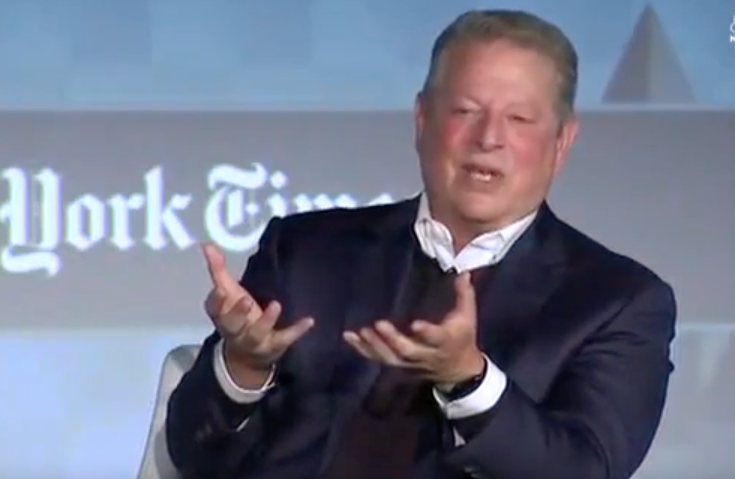
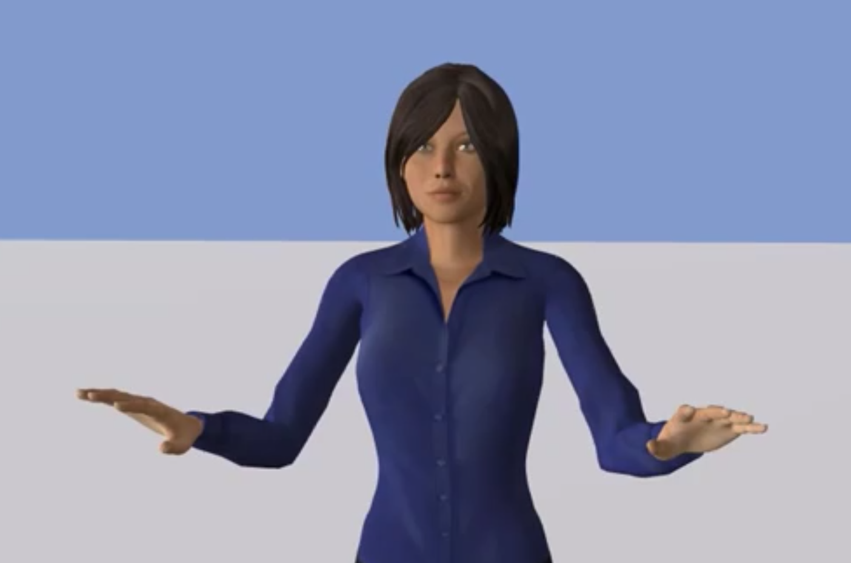
Challenges for Computational Models
Metaphor Selection
Forming animations from multiple metaphors
Selecting the right metaphor(s)

Slide 16
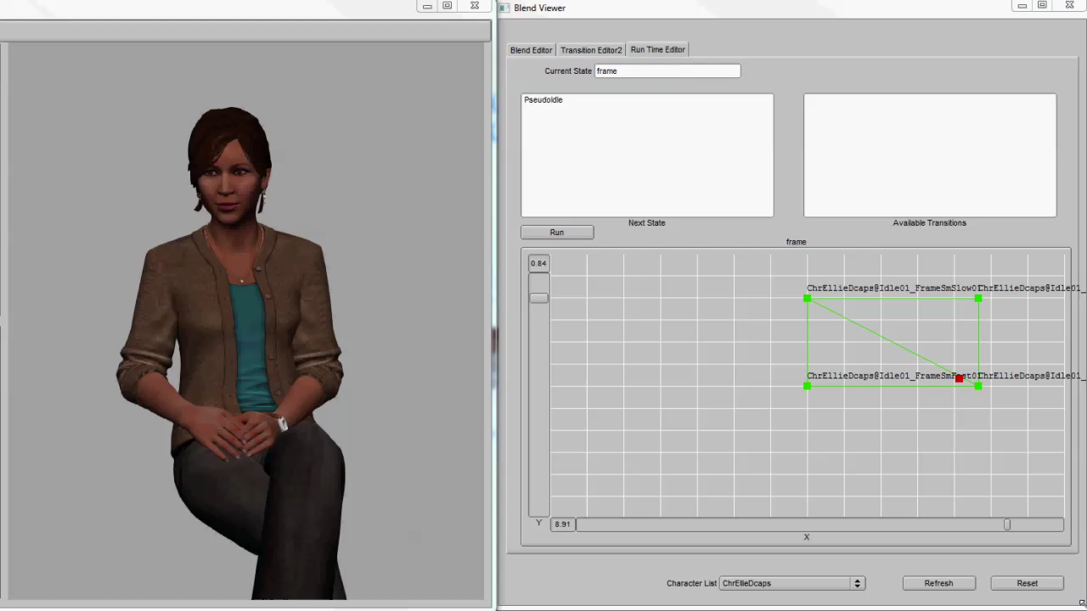
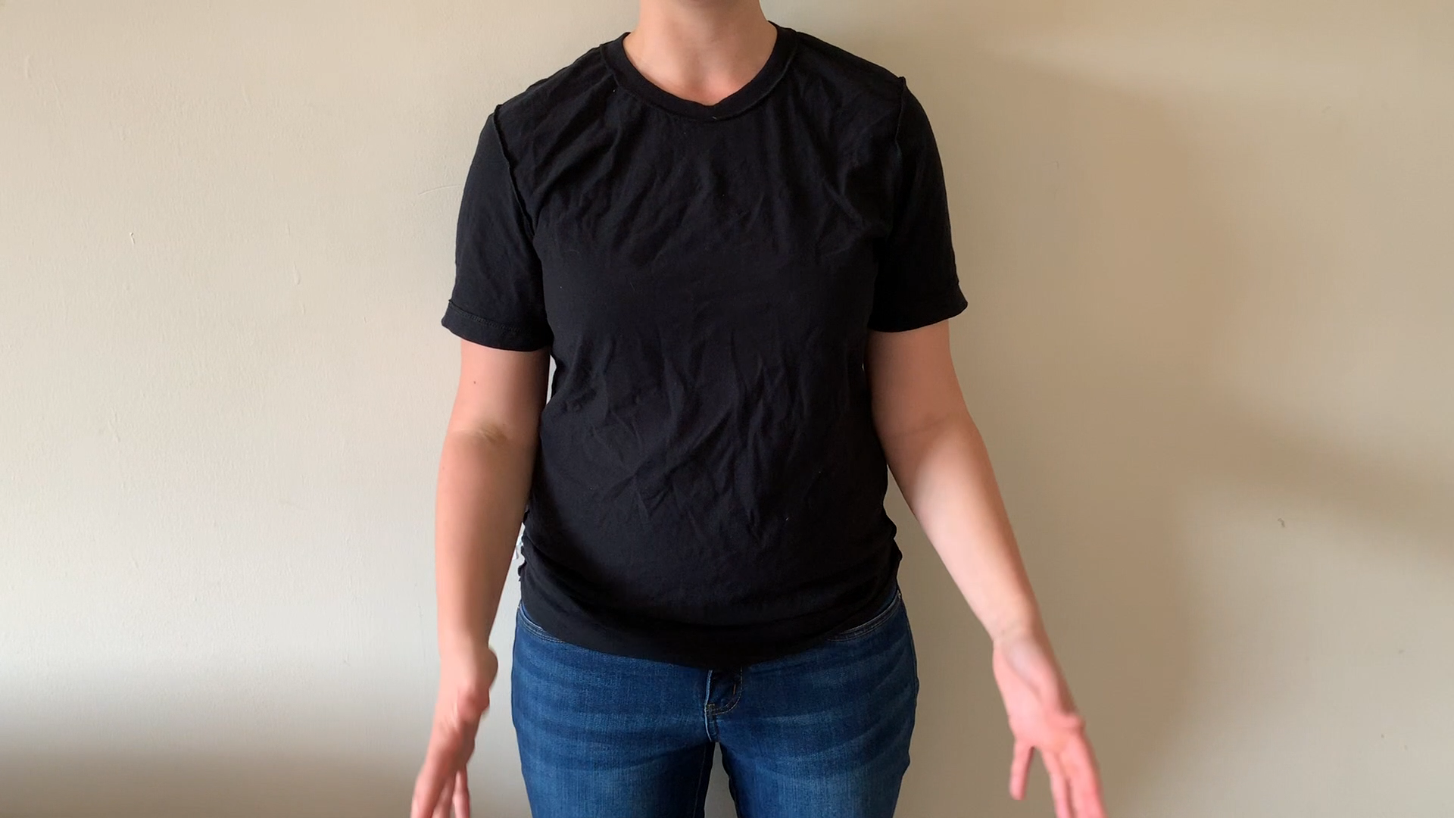
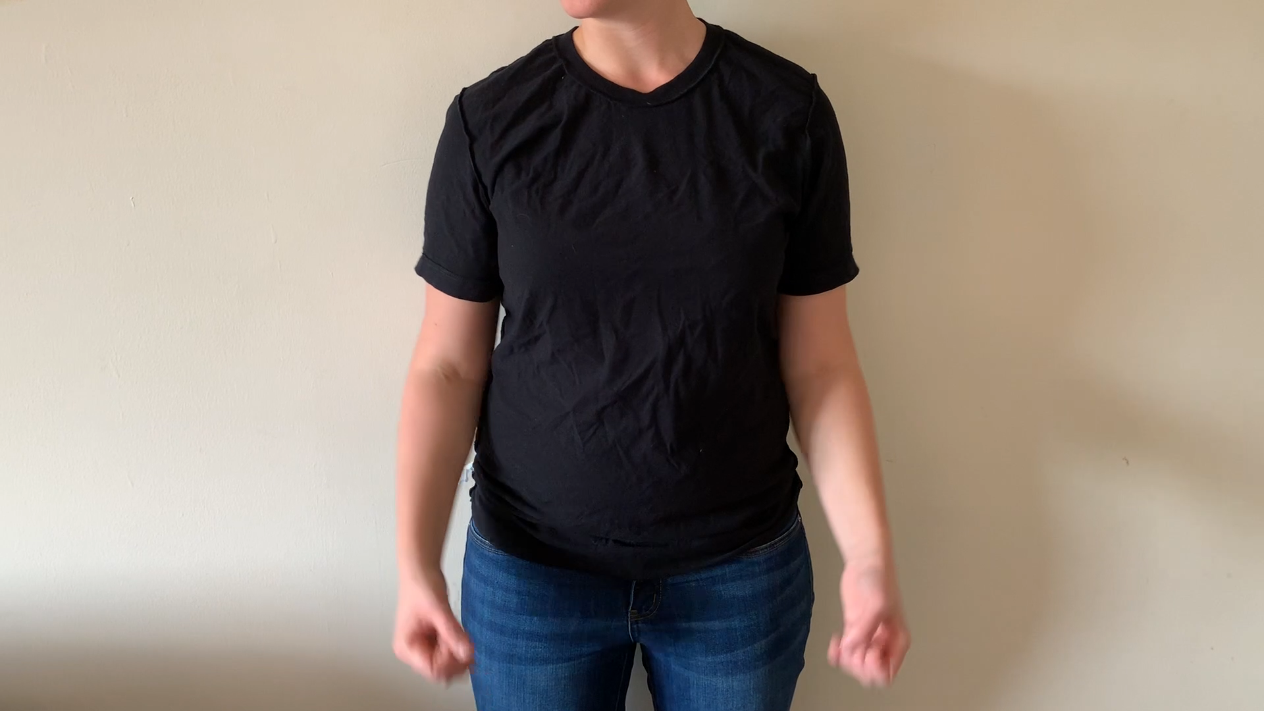
Challenges for Computational Models
Animation
Combining pre-built animations?
differences in performance of same metaphor
what parameters convey what relevant information?

Slide 17
So What Did We Learn?
Multiple Physical Metaphors carry information in a single gesture
Specific Physical Attributes? (motion capture)
behavioral
computational
Gesture across time?
MEG (implied objects)
Cross-cultural interpretation (behavioral)
Evaluating communicative efficacy in virtual agents and robots

Slide 18
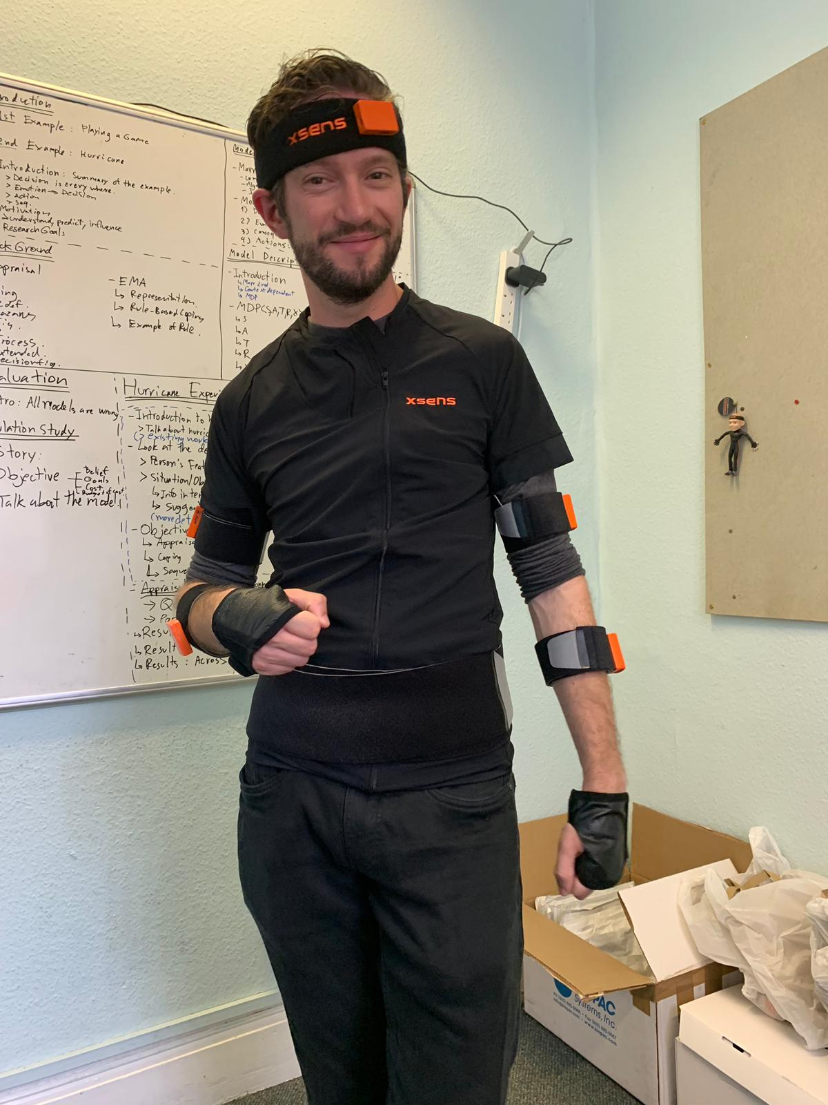
THANK YOU!!!!!!!!!!
Marion Roth
Stacy Marsella
Mathieu Chollet

Slide 19
References
D. Camacho Piris, (2017). Mover4 beso robotikoaren traiektoriak 3D ikusmen sentsorearen elikaduraz.
J. Cassell, H. Vilhjalmsso, and T. Bickmore. Beat: The behavior expression animation toolkit. In Proceedings of ACM SIGGRAPH, 2001
A. J. Cienki and J.-P. Koenig. Metaphoric gestures and some of their relations to verbal metaphoric expressions. Discourse and cognition: Bridging the gap, pages 189–204, 1998.
S. Ginosar, Bar, A., Kohavi, G., Chan, C., Owens, A., & Malik, J. (2019). Learning Individual Styles of Conversational Gesture. In Proceedings of the IEEE Conference on Computer Vision and Pattern Recognition (pp. 3497-3506).
S. Goldin-Meadow and M. W. Alibali. Gesture’s role in speaking, learning, and creating language. Annual review of psychology, 64:257– 283, 2013.
J. Grady. Foundations of meaning: Primary metaphors and primary scenes. 1997.
A. Jamalian and B. Tversky. Gestures alter thinking about time. In Proceedings of the Annual Meeting of the Cognitive Science Society, volume 34, pages 503–508, 2012.
J. Lee and S. Marsella. Nonverbal behavior generator for embodied conversational agents. In International Conference on Intelligent Virtual Agents, pages 243–255. Springer, 2006.
C.W. Leong, B.B. Klebanov, and E.Shutova. A report on the 2018 vua metaphor detection shared task. In Workshop on Figurative Language Processing, 2018. M. Lhommet and S.C. Marsella. Gesture with meaning. In International Conference on Intelligent Virtual Agents, pages 303–312. Springer, 2013.
D. McNeill. Hand and mind: What gestures reveal about thought. University of Chicago press, 1992.
B. Ravenet, C. Pelachaud, C. Clavel, and S. Marsella. Automating the production of communicative gestures in embodied characters. Frontiers in psychology, 9, 2018.
Y. Xu, C. Pelachaud, and S. Marsella. Compound gesture generation: a model based on ideational units. In International Conference on Intelligent Virtual Agents, pages 477–491. Springer, 2014.

Slide 20

Questions
University of Glasgow
https://tinyurl.com/acii19
carolyn.saund@gmail.com
@CarolynBot csaund

Slide 21
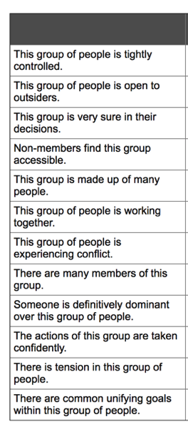
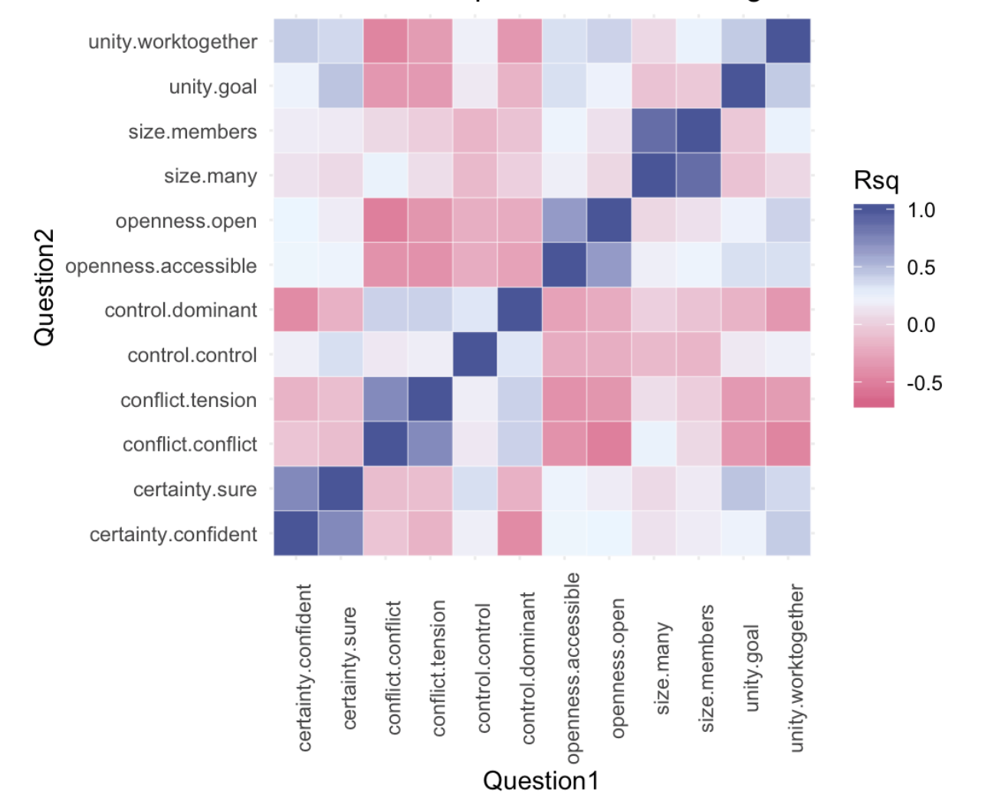
Results
Experiment
Actually, we formed groupings
Control
Conflict
Openness
Certainty
Unity
Size

Slide 22
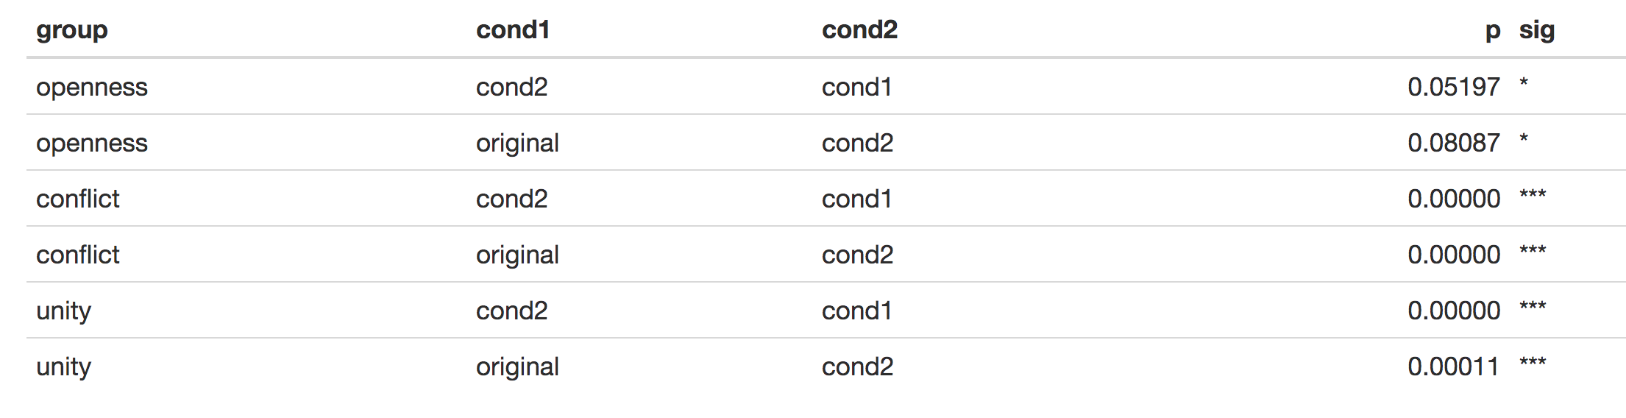
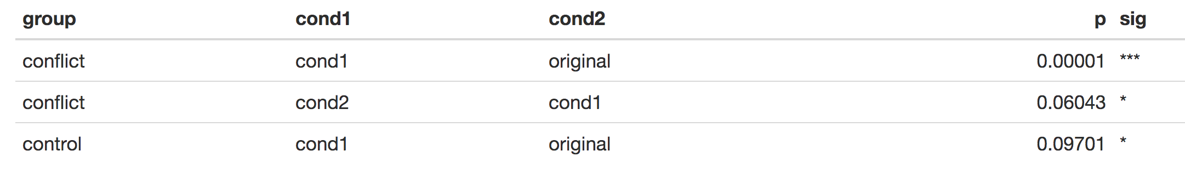
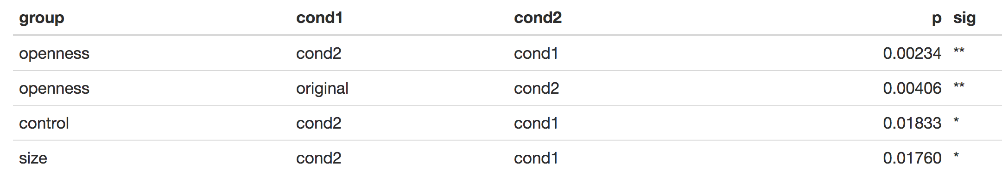
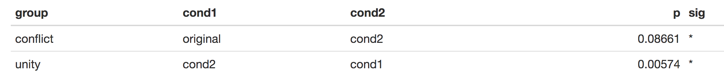
Results
Experiment
Gesture 1 — “Unpolite”
Gesture 2 — “Audience”
Gesture 3 — “Entity”
Gesture 5 — “Specific”

